Slide 1
Project Title : Online Quiz Plateform
Team Member1 Name:Govind Sharma
Team Member2 Name:Kanishk Patel
Team Member4 Name:Ritik Chauhan
University Name: GLA University
Department Name: Btech CSE
Date:

Slide 2
Introduction
Online quiz application - a modern, interactive platform transforming learning and self-assessment
We aim to bridge the gap between traditional education and modern, interactive learning.
User can attempt the quiz the and view their score and verdict so this way they can improve their knowledge in the particular subject

Slide 3
Objectives
The main objective of this project is to Build an online quiz platform that allows users to create and take quizzes on various topics, with scoring and generate reports of their scores.

Slide 4
Problem Statement
We are addressing the challenge of traditional learning's monotony and lack of personalization
Our project is important because it changes how people learn. We're creating a fun and personalized way to learn that suits each person. This helps make education more interesting and matches the needs of today's learners, making learning a lot better and more meaningful.

Slide 5
Literature Review
Several existing online learning platforms provide quizzes, but often lack adaptability and personalization. Some focus on specific subjects, while others offer generic quizzes without considering individual learning preferences
Our Project fills the gap by providing dynamically interface to the user and teachers. Teachers can create exams and add questions according to their need and they can also edit the questions and answers they can also set the timer for the quiz .

Slide 6
Methodology
The problem was tackled using the MERN stack, a technology combination known for its efficiency in building robust web applications
React was chosen for the frontend to deliver an interactive and responsive user interface. MongoDB is used for scalable database solution. Express.js and Node.js is used in the backend for seamless data handling.

Slide 7
System Architecture
Frontend (React):
User Interface (UI): Engages users and administrators with an intuitive interface.
Ant Design Components: Utilizes the Ant Design library for sleek and responsive UI components.
Backend (Node.js and Express.js):
API Layer: Manages communication between the frontend and the database.
Authentication and Authorization: Ensures secure access using JWT authentication and password hashing.
Quiz Management Logic: Facilitates the creation, editing, and deletion of exams, questions, and answers.
Database (MongoDB):
Data Storage: Stores quiz-related information, user profiles, and exam results.
State Management (Redux Toolkit):
Global State: Manages application-wide state for efficient data sharing and updates.
Timer Functionality:
Timer Library: Integrates a specialized timer library for managing exam sessions.
Result Handling:
Live Result Functionality: Displays results in real-time after users complete exams.
MongoDB Integration: Stores exam results in MongoDB for future reference and analytics.
Reports/Analytics:
Separate Modules: Provides separate reports and analytics functionality for both admins and users.

Slide 8
Implementation
Share details about the implementation process
Code snippets or screenshots if applicable

Slide 9
Features
Key Features: UI Customization, security with JWT Authentication and password hashing techniques, reports and analytic, Efficient State Management with Redux Toolkit
Unique functionalities:Admin Empowernment, Cusomizable Timer Library

Slide 10
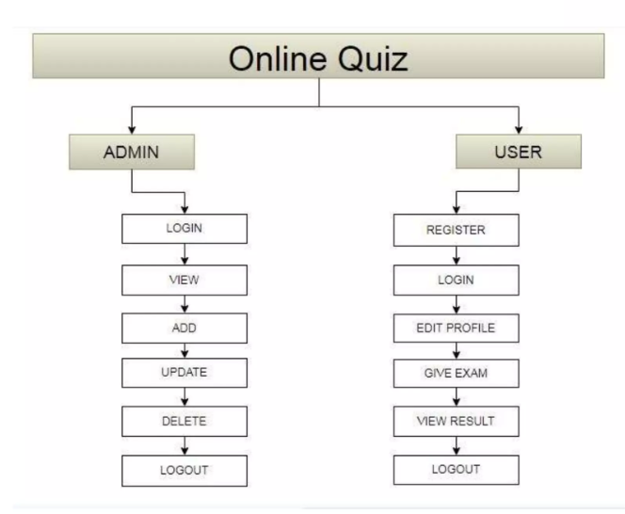
Results
Showcase the results or outcomes of your project
Graphs, charts, or any visual representation

Slide 11
Challenges Faced
During the devlopment process of this project we faced many challenges like Implementing robust JWT authentication and secure password hashing , ui design for admin and in MongoDB Schemas
We overcome up from these challenges by Regular communication and knowledge-sharing among team members and by reading official documentation and by searching on internet.

Slide 12
Future Work
In future we will add some features like admin can create quiz by just giving the topic name through AI so it will be time saving and
we will also add feature to allow admins to add multimedia elements (images, videos) to questions, providing a richer quiz creation experience.

Slide 13
Conclusion
Key Features: Comprehensive Learning Journey, admin Empowerment, Functionalities, Security and Analytic
Significance of project: Educational Empowerment, Innovative Features

Slide 14
Acknowledgments
Thank anyone who contributed to the project, including professors, peers, or anyone else who supported you

Slide 15
Q&A
Open the floor for questions from the audience

